Slide 1

Little River Band of Ottawa Indians
Financial Report
August 2025

Slide 2
Financial Highlights
During the month of August 2025, the Tribe received a distribution of $3,588,800 from LRCR for July 2025 activity, which is $739,326 more than the $2,849,474 budgeted.
In the month of August 2024, the Tribe received $3,664,203 in distribution for activity of July 2024.

Slide 3
Financial Highlights
As of August 2025, total cash was $90,160,890 compared to a total cash balance as of December 2024 of $78,616,287 for an increase of $12,544,613 in cash position.
Of the available cash balance, $57,108,453 is restricted for defined purposes through various limitations imposed by Tribal Council or conditions of Federal grants.

Slide 4
Cash Position 2025 & 2024

Slide 5
Major Sources Of Revenue

Slide 6
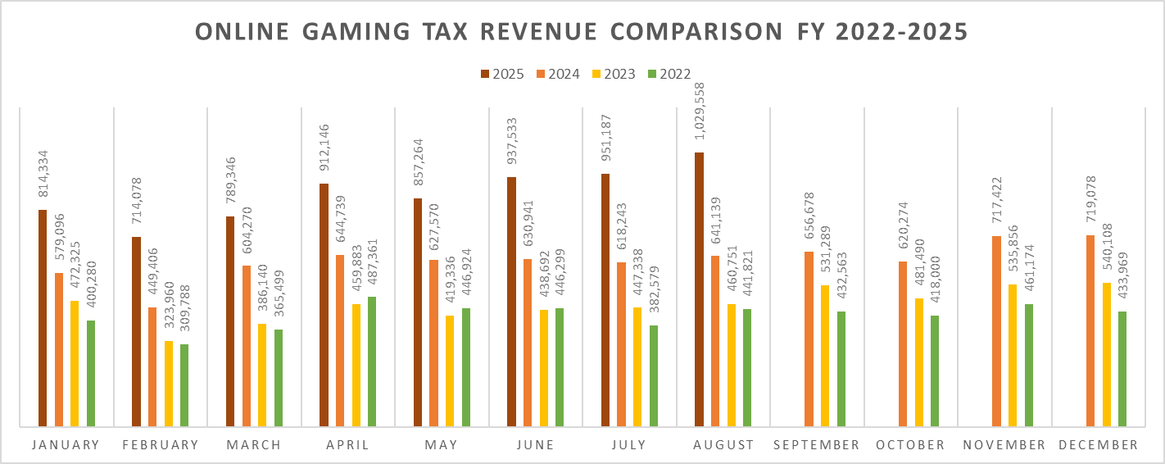
Online Gaming Tax Comparison

Slide 7
Major Expenditures

Slide 8
Tribal Citizen Benefits

Slide 9

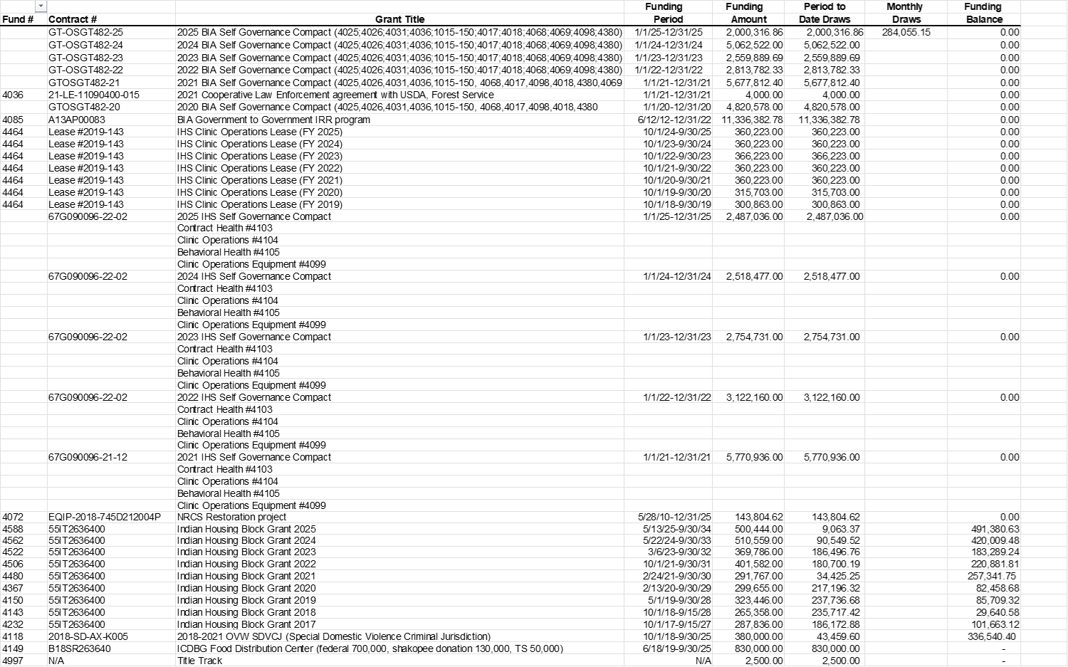
Grant Draws – August 2025

Slide 11
Any Questions?
THANK YOU!

